Slide 1
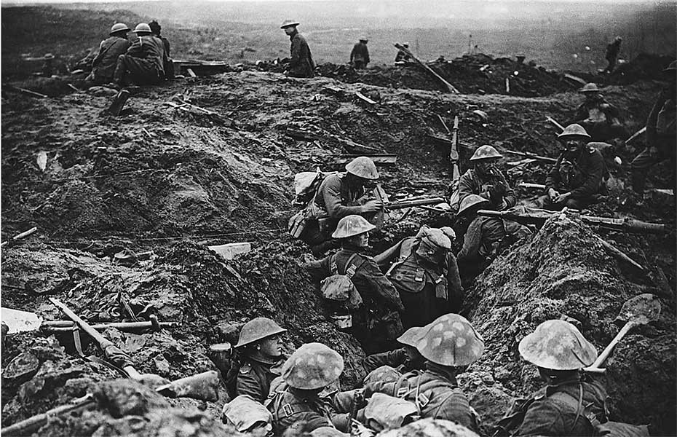
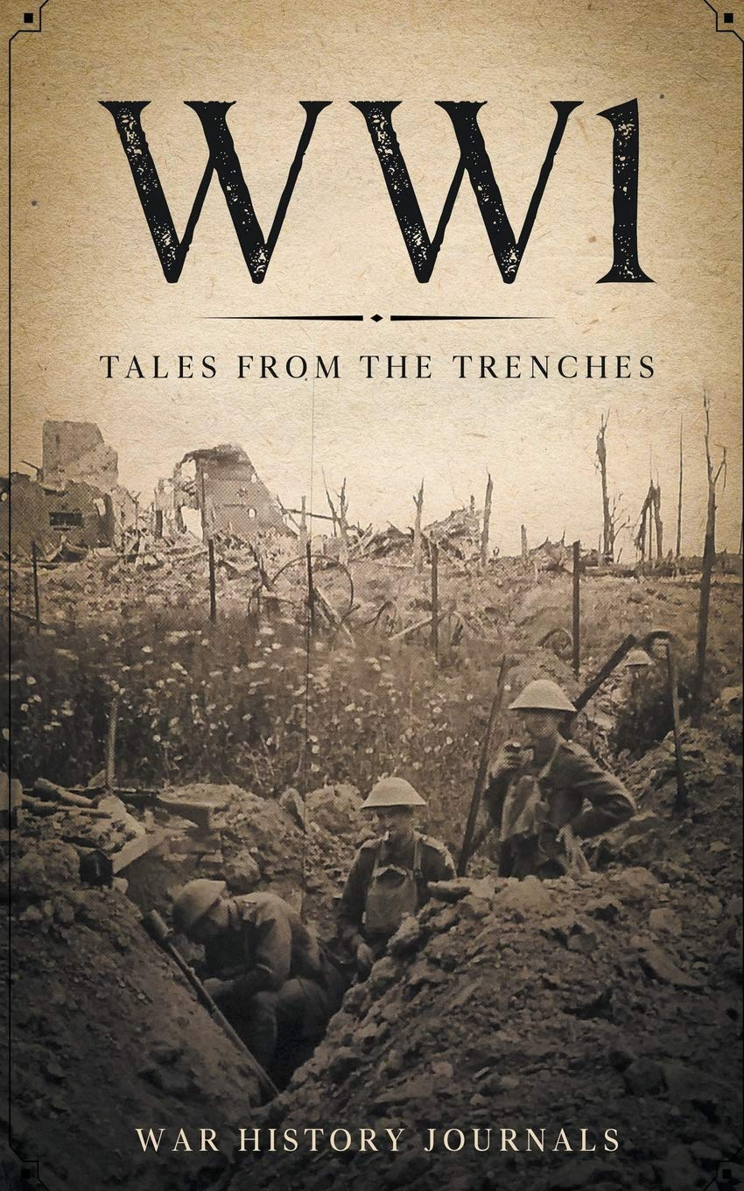
World War 1
Primary 7 project St. Joseph’s Meigh
By Jamie McParland

Slide 2
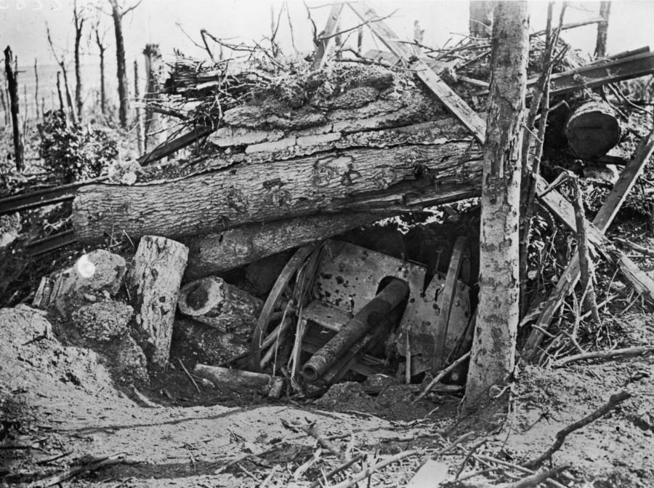
Contents
Introduction
Maps of the World during WW1
Trenches
Battles
10 Deadliest Weapons of WW1
Animals Helping in WW1
America joins the War
The War is over
Conclusion

Slide 3
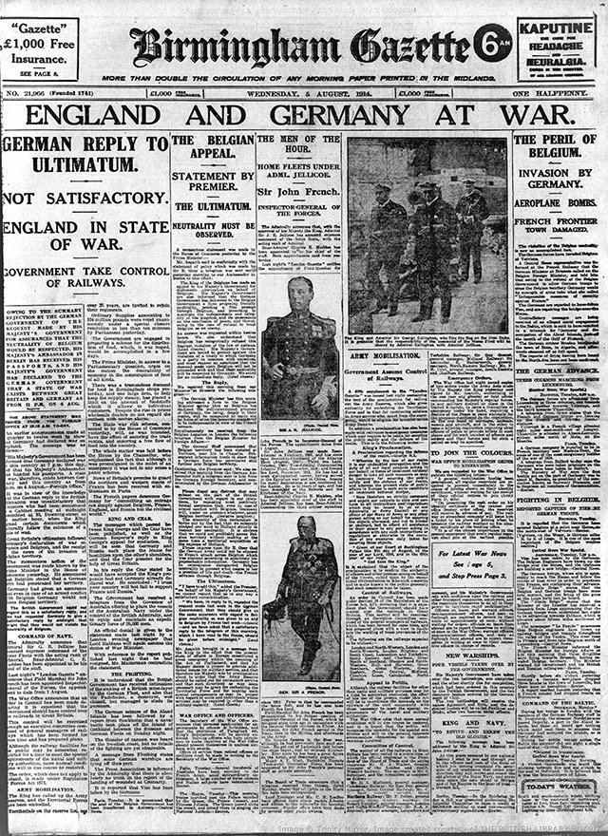
Introduction
On July 28th 1914 began the outbreak of the First World War, aka World War 1 or The Great War for Civilisation
World War 1 Why did it start?
The Allies — the British Empire, France, Belgium, Russia and later, the USA — were in one family. And the Central Powers of Germany, Austria, Hungary, Bulgaria and Turkey were in the other. On 4 August 1914, Germany invaded Belgium, and so, standing by its promise to stick up for Belgium, Britain declared war on Germany. The world was at war…

Slide 4
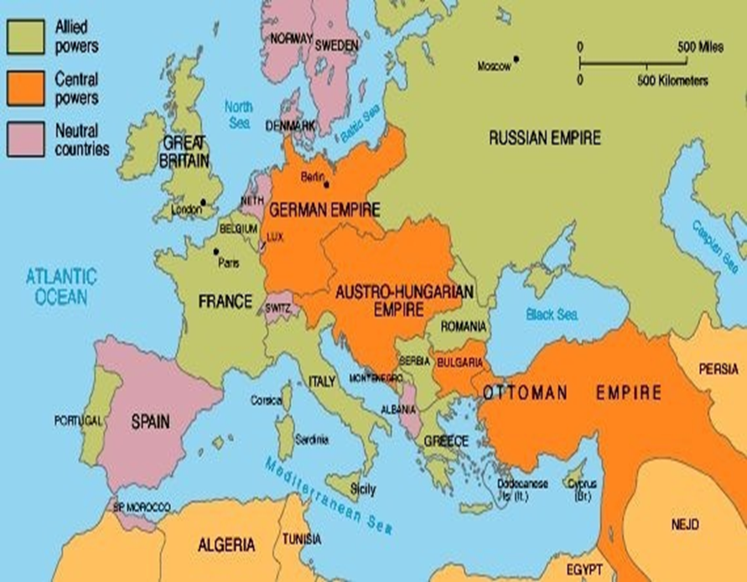
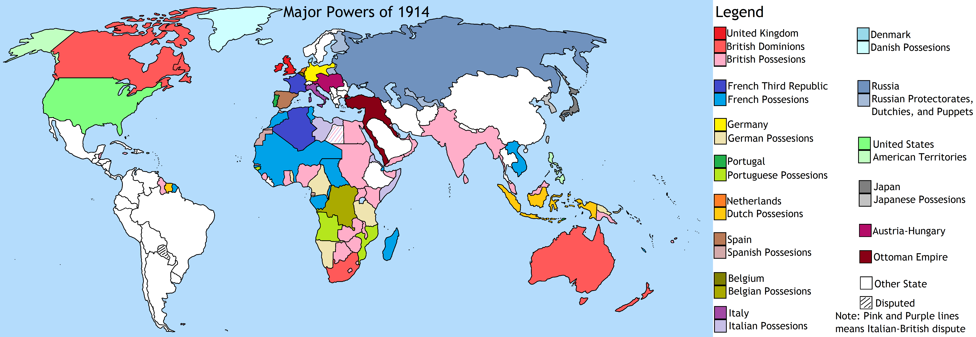
Maps of the World during WW1

Slide 5
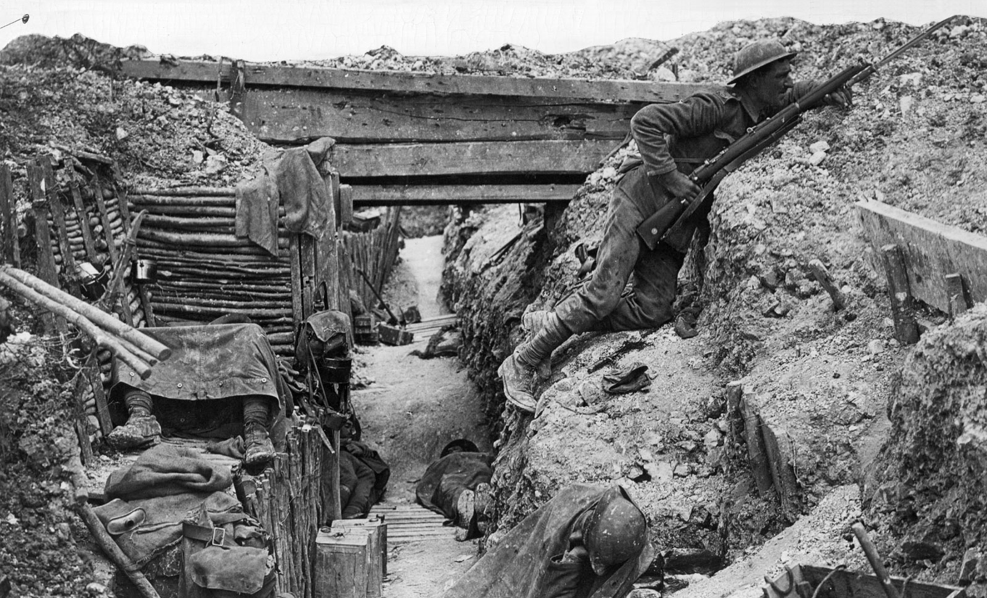
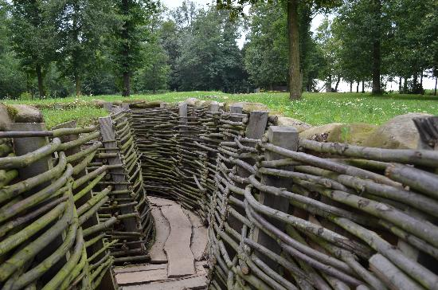
Trenches
Trench warfare lasted for many years on the Western Front during World War 1.
Trench warfare was miserable for both alliances. Dead bodies, large rats, lice infestations and overflowing latrines were an everyday part of life in the trenches. Alongside the constant threat from the enemy.
No man’s land was a term used to reference the area between both sides’ trenches. This area could be as wide as 600 feet or as short as 30 feet.
Sometimes soldiers had to eat rats if they were running low on food.
TripAdvisor
Trench Warfare - Picture of Flanders Fields Battlefield Daytours, Bruges - Tripadvisor

Slide 6
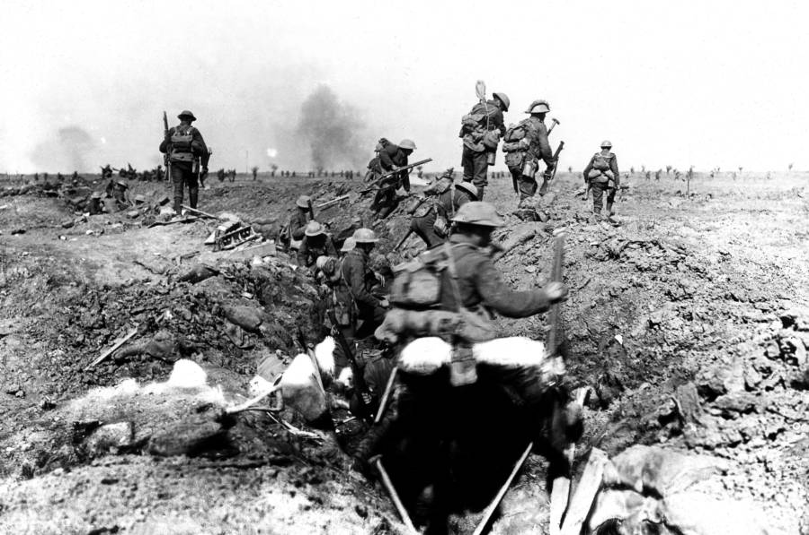
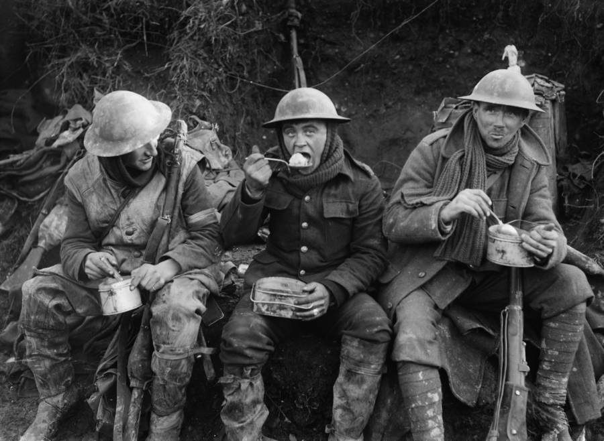
Battles
During the 1st month of World War 1, the Battle of Tannenberg was fought between August 26th and August 30th, 1914. The German Empire almost destroyed the entire Russian Second Army.
At the Battle of the Somme the German Empire fought the United Kingdom and the French Empire on both sides of the upper reaches of the River Somme in France. The Battle of the Somme is considered one of the bloodiest battles in the history of warfare with over one million casualties. On the first day of battle alone, nearly 20,000 men died.
The average soldier had to carry 66 pounds of equipment.
The longest battle of World War 1 was the Battle of Verdun. The German Empire fought the French Empire for 9 months, 3 weeks and 6 days on the hills north of Verdun-sur-Meuse on the Western Front.

Slide 7
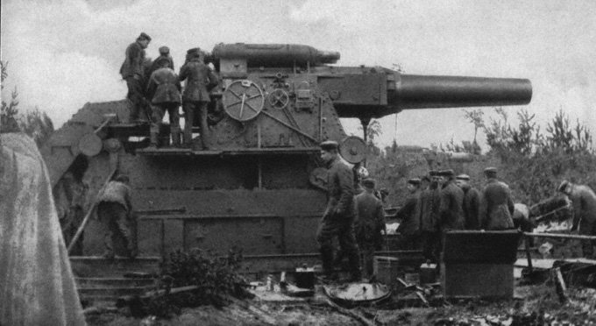
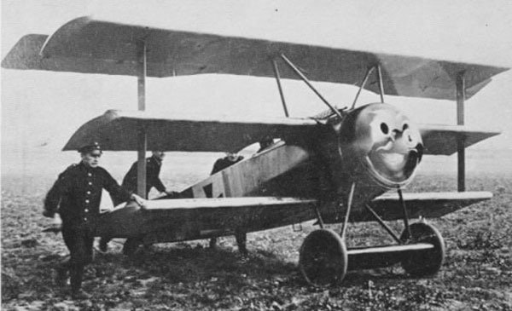
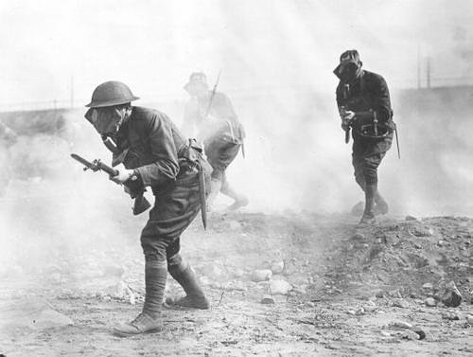
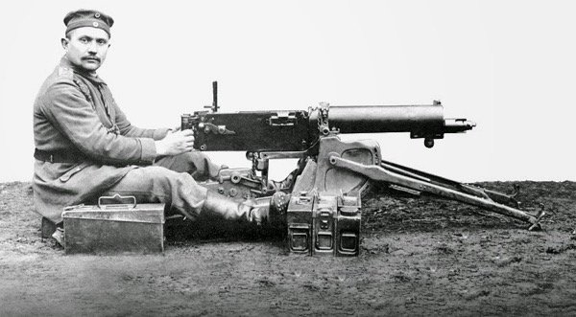
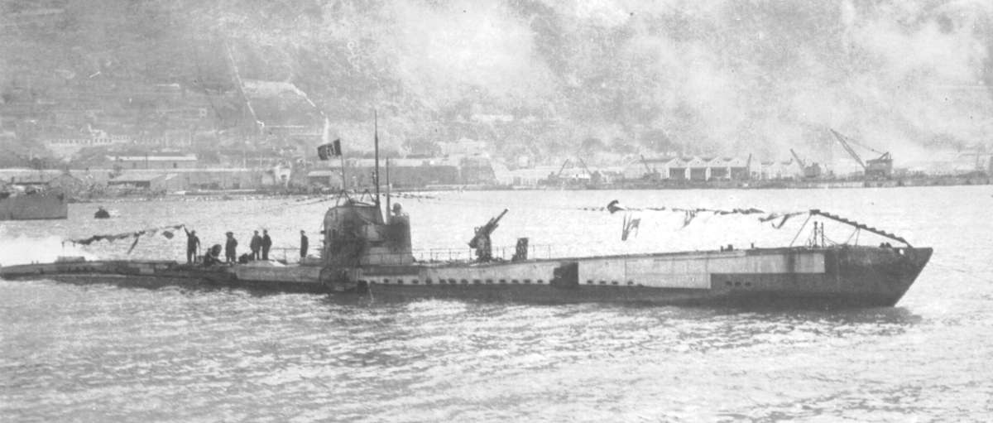
Top 10 Deadliest Weapons of World War 1
10. Barbed Wire
9. Big Bertha
8. Fokker Triplane The Fokker Triplane is the most famous airplane of the First World War and was the German response to the famous British Sopwith Triplane
7. Artillery Gun
6. Machine Guns: Maxim MG 08
5. Chlorarsine and Mustard Gas
Chlorarsine is one of a group of chemical weapons classified as a vomiting agent or sneezing gas. It caused short-term but intense respiratory distress which was designed to temporarily disable and terrify the enemy troops.Mustard gas or sulfur mustard caused large blisters on the skin and lungs.
4. Phosgene and Tear Gas Chemical warfare during the First World War included different types of chemicals. About 1 percent of wartime fatalities and 7 percent of casualties were the result of poison gases.
3. Mark V Tank
2. Airships
1. Type 93 U-Boat
It’s estimated that over 9.9 million military personnel were killed in World War 1.
It’s estimated that over 7.7 million civilians were killed in World War 1.
The Type 93 U-boat was one of the most lethal weapons used during the First World War by the Imperial German Navy.

Slide 8
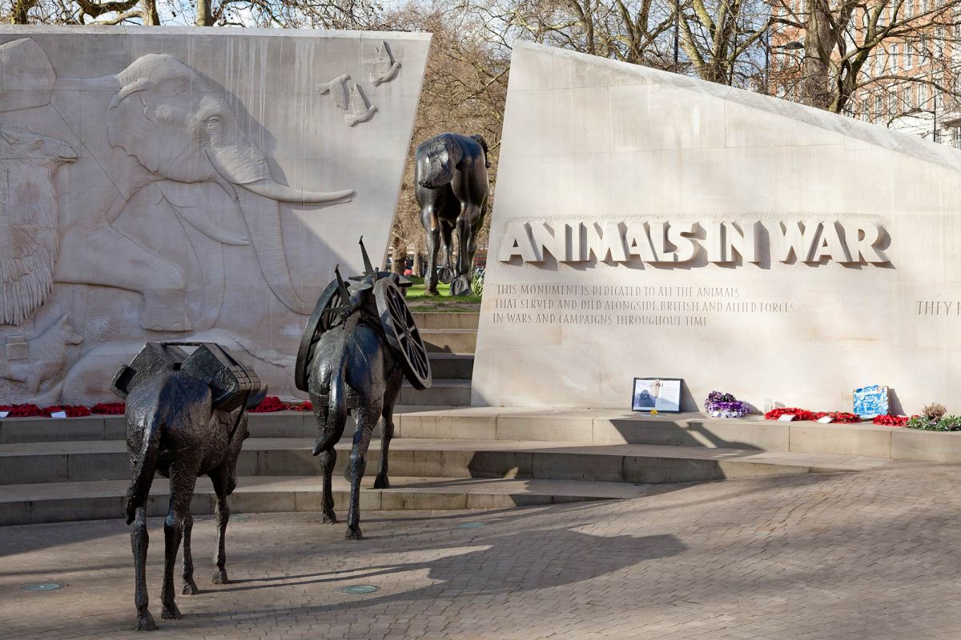
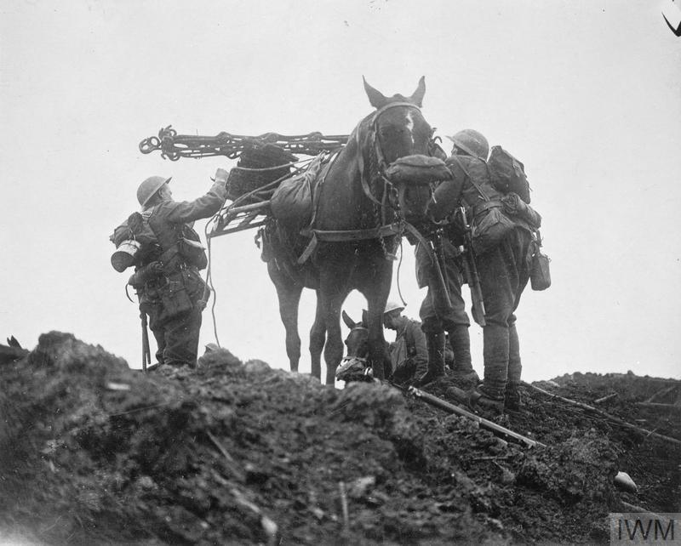
Animals helping in WW1
Pigeons
Pigeons played a crucial role in communication during World War I because of their speed and ability to fly at great heights. Their homing instincts also made pigeons extremely reliable and capable messengers—they could easily find their way back to their loft. Both the Allied and the Central Powers used tens of thousands of homing pigeons to send messages between military detachments.
Dogs
Like homing pigeons, Allied and Central Powers used dogs as messengers during World War I. Dogs could easily and much more subtly navigate trenches and battlefields than soldiers could, thus making them ideal ground messengers.
Dogs also served in several other capacities—for example, their keen sense of smell made them perfectly suited to finding wounded soldiers on the battlefield and in the trenches. This sense of smell, combined with dogs' excellent hearing, allowed them to serve as effective guards and scouts, particularly when it came to detecting nearby enemies. Man's best friend also filled the simple but essential need for comfort and companionship during times of great distress.
Horses and Mules
Dogs and pigeons played a crucial a role in World War I, but horses and mules are perhaps the animals most commonly associated with the Great War.
They were used as beasts of burden to pull pieces of artillery, supply trains, and other materials. Horses also served as transportation for soldiers and as integral members of cavalry units. In fact, horses and their transportation capabilities were so important on the battlefields of the Great War that they were seen as the key to saving soldiers’ lives.
Slugs
By the time soldiers noticed the presence of mustard gas on the battlefield, it was often too late. Dr. Paul Bartsch of the Division of Mollusks in the U.S. National Museum (now the National Museum of Natural History) discovered that slugs could detect mustard gas well before humans could. The slugs would visibly indicate their discomfort by closing their breathing pores and compressing their bodies, and soldiers in the trenches would quickly put on their gas masks to protect themselves from harmful levels of gas. The "slug brigade" ended up saving many lives.

Slide 9
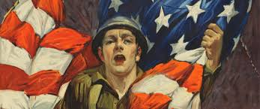
America Join The War
The U.S. entered World War I because Germany embarked on a deadly gamble. Germany sank many American merchant ships around the British Isles which prompted the American entry into the war.
After the first American troops landed in Europe in June 1917 the involvement of the United States escalated rapidly. By the end of the war in November 1918 10,000 American troops were arriving in France every day. Questions have been asked by historians as to how effective the United States forces were on the battle field, but acknowledge that the simple replenishment of the numbers of allied forces at the front had a significant impact. At the close of the war 53,402 Americans had been killed in combat and over 200,000 had been wounded. The entry of the United States meant that President Wilson was able to play a key role in the peace talks at Versailles that would redraw the map of Europe, and it is clear that wartime manufacturing greatly benefitted the American economy.

Slide 10
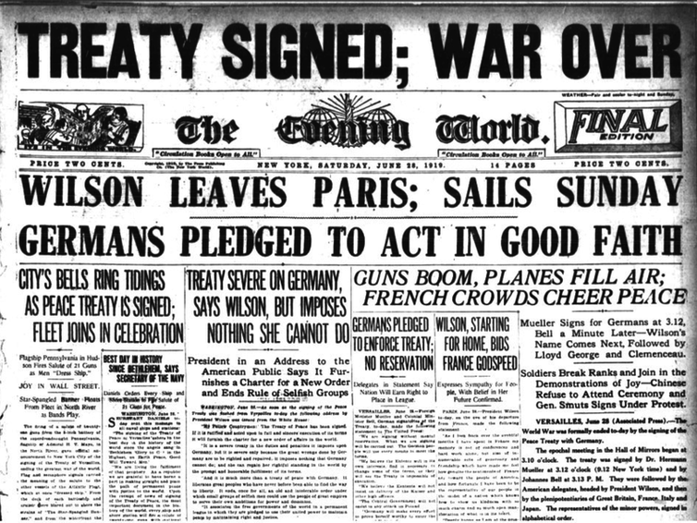
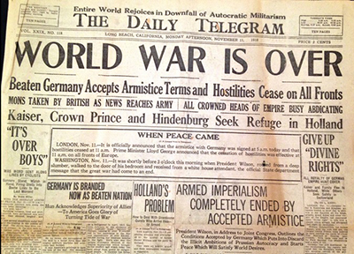
The War is Over!!
Germany had formally surrendered on November 11, 1918, and all nations had agreed to stop fighting while the terms of peace were negotiated. On June 28, 1919, Germany and the Allied Nations (including Britain, France, Italy and Russia) signed the Treaty of Versailles, formally ending the war.
The Treaty of Versailles ended the state of war between Germany and the Allied Powers.
The Treaty of Versailles held Germany responsible for starting the war and imposed harsh penalties in terms of loss of territory, massive reparations payments and demilitarization

Slide 11
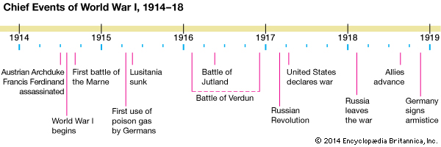
Conclusion
World War I, also known as the Great War, began in 1914 after the assassination of Archduke Franz Ferdinand of Austria. ... By the time the war was over in 1918 and the Allied Powers claimed victory, more than 16 million people—soldiers and civilians alike—were dead.

